Slide 1


Slide 2


Queue Management For Parking
Second Year Project Synopsis
Submitted by
ROLL | NAME
2301010283 | PIHU PANDEY
2301010320 | DIKSHA
2301010335 | PAYAL
2301010326 | KASHISH
Industry Mentor: Mr. Manvith Kumar
Faculty Mentor: Dr. Tanvi Chawla
Notes:
New Courses replaced with New Programmes

Slide 3
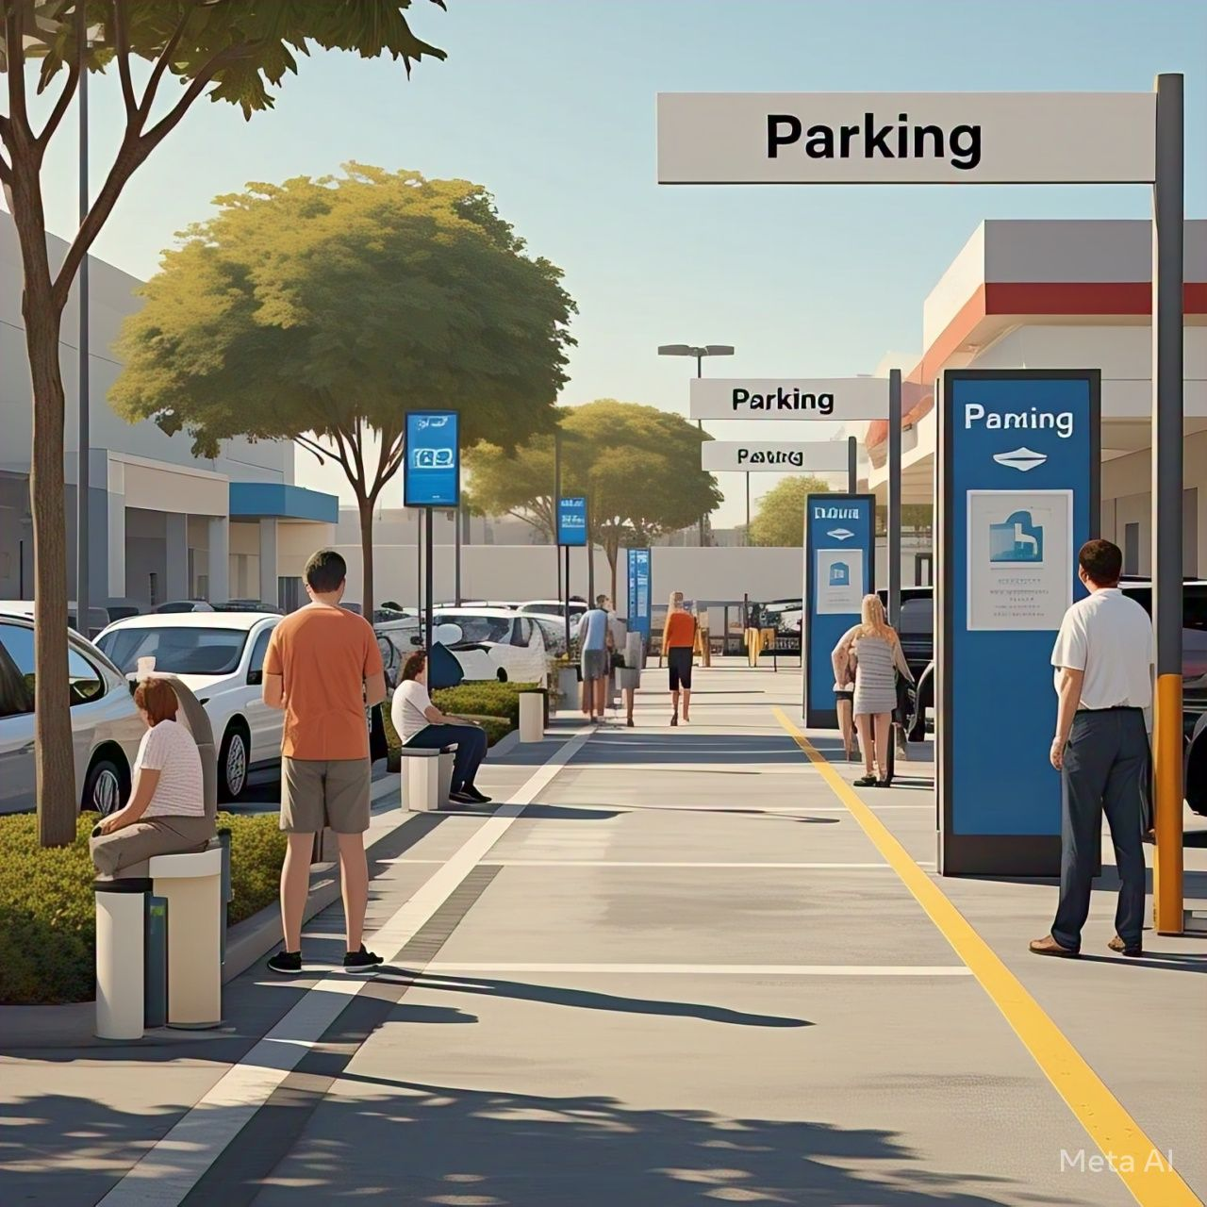

Project Overview
Queue management for parking focuses on optimizing the flow of vehicles within parking facilities to reduce congestion, improve customer satisfaction, and maximize space utilization. By implementing strategies such as real-time availability tracking through sensors and mobile apps, pre-booking systems, and dynamic pricing during peak times, parking facilities can better manage demand. The benefits of effective queue management are numerous, including reduced congestion, improved customer experiences, increased revenue, and a more environmentally friendly system with fewer vehicles idling. Ultimately, efficient parking queue management is essential for ensuring smooth operations and adapting to future trends, like autonomous vehicles and AI-driven solutions.
Notes:
New Courses replaced with New Programmes

Slide 4
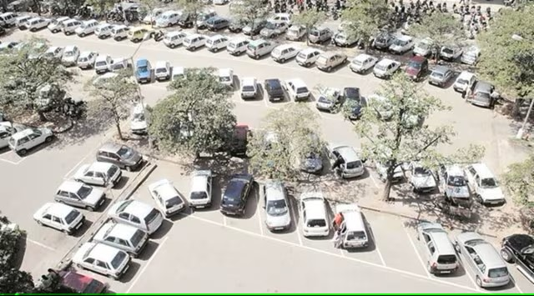
About the Problem
Congestion and Long Wait Times: High demand for limited parking spots often leads to long wait times and traffic backups, especially during peak hours or events.
Inefficient Space Utilization: Parking lots may have empty spaces that are not immediately visible or accessible, leading to drivers circling around, wasting time and fuel.
Lack of Real-time Information: Without real-time updates on parking availability, drivers may waste time searching for a spot, leading to frustration and unnecessary congestion.
Poor Traffic Flow: Inadequate signage or poorly designed parking layouts can cause confusion and inefficient traffic flow, further contributing to delays and chaos.
Notes:
New Courses replaced with New Programmes

Slide 5
Problem Statement
The primary problem in queue management for parking is inefficient traffic flow and parking space utilization, which leads to congestion, long wait times, and driver frustration. Parking facilities often struggle with overcrowding during peak hours and insufficient real-time information for drivers about available spaces, forcing them to circle around looking for spots.
Why is it Important?
This problem is critical because inefficient parking management affects both the driver experience and the overall efficiency of parking operations. Drivers waste time and fuel, contributing to increased congestion, air pollution, and stress, while parking facilities fail to maximize their revenue potential. For businesses and cities, it can lead to lost customers, reduced profits, and a negative impact on reputation.
Expected Impact of Solving the Problem:
Reduced Congestion: By improving traffic flow and reducing waiting times, parking facilities can minimize congestion in and around the area.
Improved Customer Satisfaction: A smoother parking experience with real-time availability, easy payment, and optimized layouts will increase driver satisfaction.
Notes:
New Courses replaced with New Programmes

Slide 6
Objectives
The main goal of this project is to optimize parking queue management, improving traffic flow, space utilization, and overall user experience within parking facilities.
Specific Objectives:
Implement real-time parking availability tracking using sensors and mobile apps to reduce search times.
Enhance traffic flow with improved signage, better parking lot layout, and clear navigation.
Introduce a pre-booking and dynamic pricing system to manage demand and maximize revenue.
Streamline payment processes with automated and contactless systems to reduce bottlenecks and delays.
Notes:
New Courses replaced with New Programmes

Slide 7
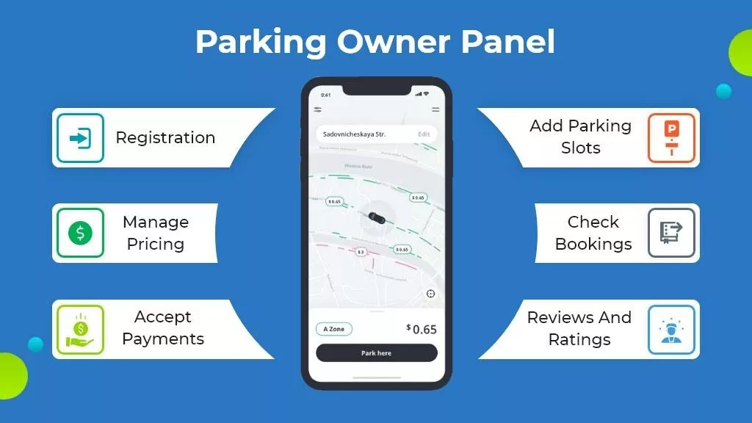
SYSTEM ARCHITECTURE
Client (Browser)
Frontend (HTML/JS)
Backend (Node.js, Java APIs)
Database (MongoDB)
Modules: Login, Booking, Queue Management, Payment, Admin Dashboard
Notes:
New Courses replaced with New Programmes

Slide 8
KEY FEATURES
Secure login and registration
Slot booking with queue generation
Real-time vehicle detection and queue updates
Integrated online payments
Admin monitoring dashboard
TECHNOLOGY STACK
Frontend: HTML, CSS, JavaScript
Backend: Node.js, Java APIs
Database: MySQL / MongoDB
Tools: Postman, GitHub
Notes:
New Courses replaced with New Programmes

Slide 9
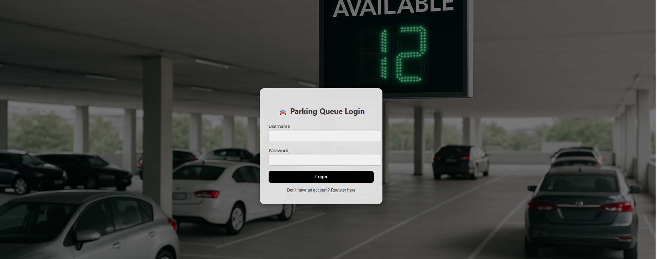
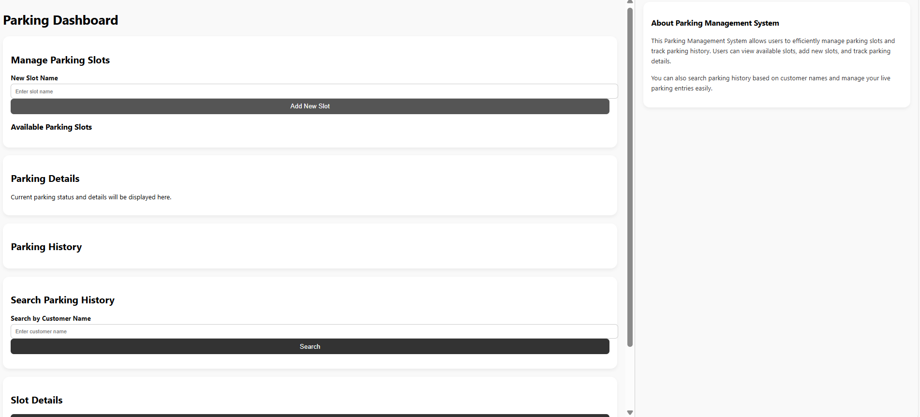
DATABASE DESIGN
Tables: Users, Vehicles, Bookings, Payments
Relationships: Users to Bookings, Vehicles to Bookings, Bookings to Payments
Notes:
New Courses replaced with New Programmes

Slide 10
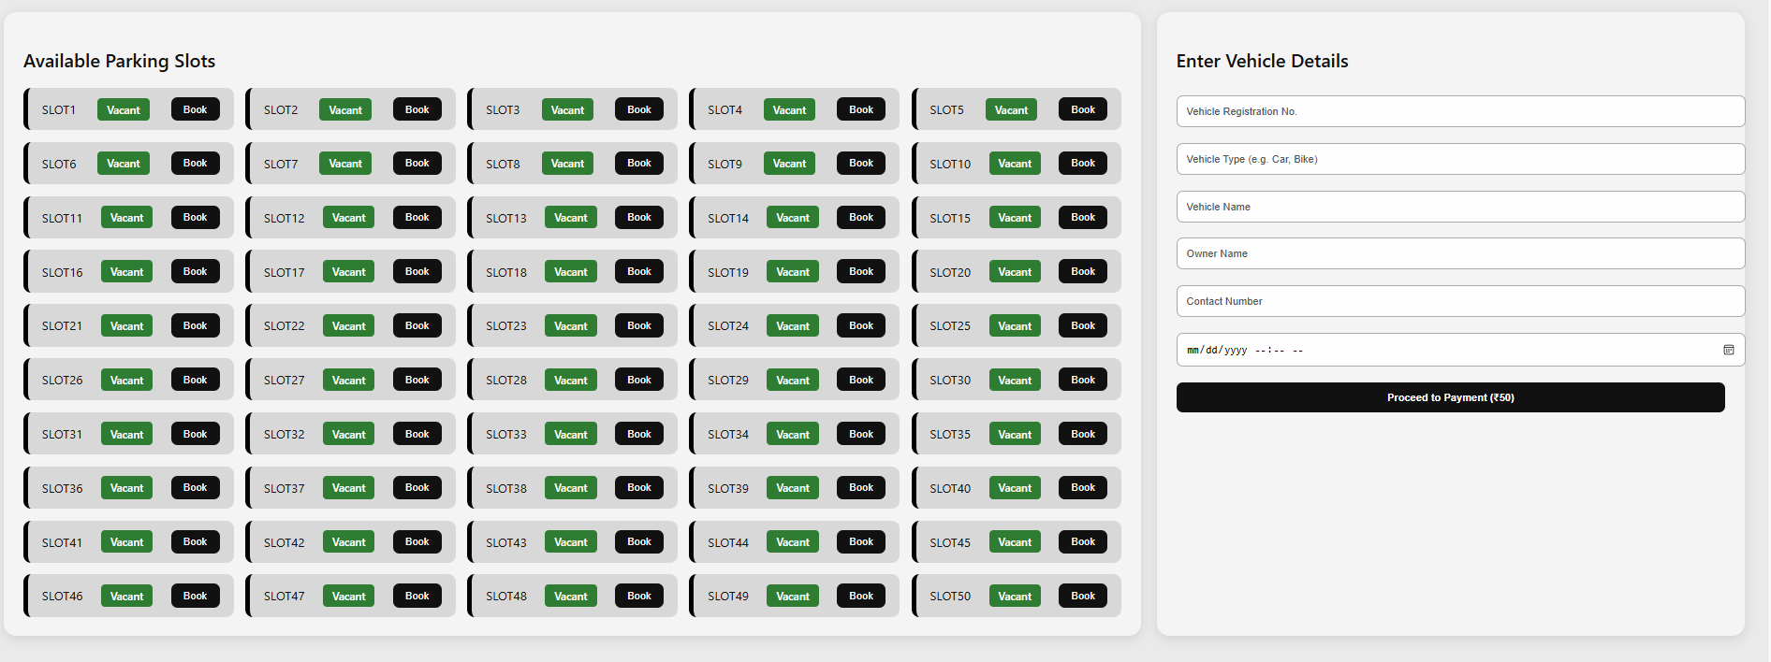
DATABASE DESIGN
Notes:
New Courses replaced with New Programmes

Slide 11
Future Scope
AI-based slot prediction
IoT sensors for automatic detection
Dynamic pricing integration
Expansion to multi-level/multi-location parking lots

